Slide 1
CHAPTER 5
IMAGE SENSING AND ACQUISITION

Slide 2
WHAT WILL WE LEARN?
What are the main parameters involved in the design of an image acquisition solution?
How do contemporary image sensors work?
What is image digitization and what are the main parameters that impact the digitization of an image or video clip?
What is sampling?
What is quantization?
How can I use MATLAB to resample or requantize an image?

Slide 3
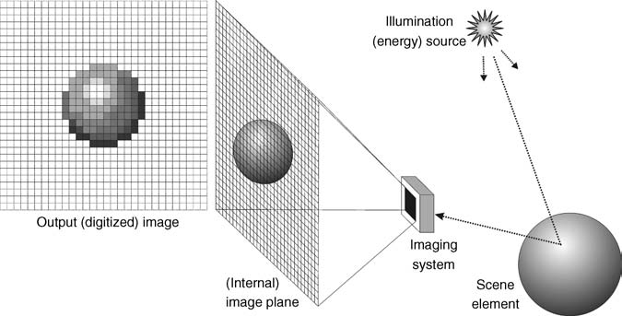
Image acquisition, formation, and digitization

Slide 4
Types of Images
Images can be classified into three categories
Reflection Images (ảnh phản chiếu - surfaces of objects)
Emission Images (ảnh phát xạ - stars and light bulbs)
Absorption Images (ảnh hấp thụ) (X-ray image)

Slide 5
Color Encoding and Representation
Human perception of light is describded in 3 parameters:
Brightness
Hue
Saturation

Slide 6
IMAGE ACQUISITION

Slide 7
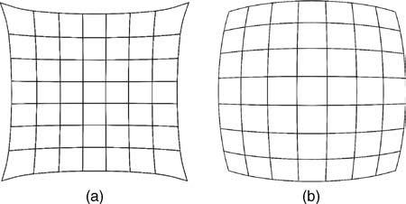
Camera Optics
Examples of lens aberrations:
(a) pincushion distortion; (b) barrel distortion

Slide 8
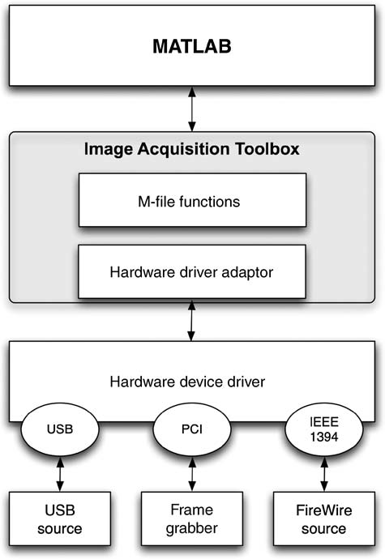
IMAGE DIGITIZATION
Two processes
Sampling
Quantization

Slide 9
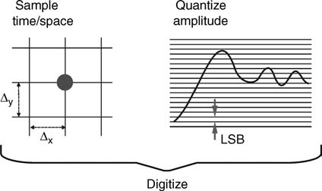
IMAGE DIGITIZATION
Digitization = sampling + quantization

Slide 10
Sampling
Sampling is the process of measuring the value of a 2D function at discrete intervals along the x and y dimensions.
Two parameters must be taken into account when sampling images
sampling rate: number of samples across the height and width of the image
sampling pattern: the physical arrangement of the samples

Slide 11
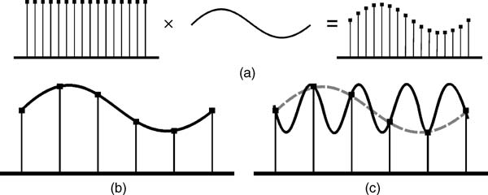
Sampling
sampling process, (b) result of reconstructing a signal from an appropriate number of samples,
(c) the same number of samples as in (b) would be insufficient to reconstruct a signal with higher frequency.

Slide 12
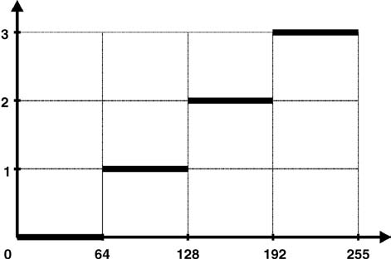
Quantization
Quantization is the process of replacing a continuously varying function with a discrete set of quantization levels.
Image quantization can be described as a mapping process by which groups of data points (several pixels within a range of gray values) are mapped to a single point.
A mapping function for uniform quantization
(N = 4).

Slide 13
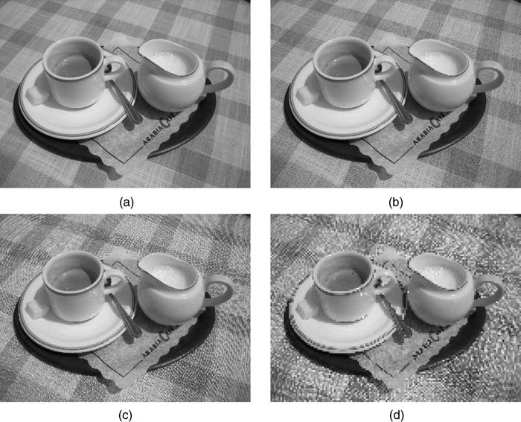
Spatial and Gray-Level Resolution
Spatial resolution expresses the density of pixels in an image (dots per inch (dpi))
Example: the original image (a) is of size 1944 × 2592 and it is displayed at 1250 dpi. The three other images (b - d) have reduced spatial resolution to 300, 150, and 72 dpi, respectively

Slide 14
In MATLAB
grayslice
I1 = imread(’ml_gray_640_by_480_256.png’);
I2 = grayslice(I1,128); figure, imshow(I2,gray(128));
I3 = grayslice(I1,64); figure, imshow(I3,gray(64));

Slide 15
PROBLEMS
5.1-5.3 page 101-102 in textbook
Practice: write a function to quantize an image.
(see Quantization.m)

